Slide 1


Smart Digital Internship and Skill Tracking System
SIMATS ENGINEERING
Saveetha Institute of Medical and Technical Sciences
Chennai-602105
CSA4304-INTERNET PROGRAMMING
Presented by:
N.Dimple blossom (192411227)
L. Deepthi (192411213)
Ch Rama Tulasi(192411258)
Guided by-
Dr.M.Sathiyamoorthy

Slide 2
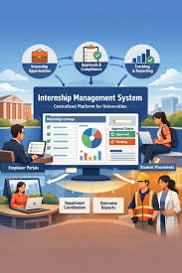
INTRODUCTION
A web-based system for managing internships and tracking student skills digitally.
Provides a centralized platform to store internship details and certificates securely.
Helps students update their profiles, skills, and internship progress online.
Allows faculty to monitor, verify, and evaluate student internship activities.
Developed using HTML, CSS, JavaScript, PHP, and MySQL for efficient and secure internship management.

Slide 3

PROBLEM STATEMENT
Internship records are often maintained manually using paper documents or spreadsheets, making them difficult to manage.
Students face challenges in tracking their internship progress, skills, and certificates in one place.
Faculty members find it difficult to monitor and verify internship activities efficiently.
Manual record management increases the chances of data loss, duplication, and errors.
There is a need for a secure, centralized web-based system to simplify internship management and skill tracking.

Slide 4
OBJECTIVES
Develop a web-based system to manage student internship details.
Allow students to update their skills, certificates, and profiles.
Enable faculty to verify and monitor internship records. Reduce paperwork by storing all information digitally.
Track student internship progress and skill development.
Generate reports for students and faculty to improve internship management.

Slide 5
LITERATURE SURVEY
S.NO | YEAR | AUTHOR | TITLE | KEY FINDINGS
1 | 2026 | Harson Kapoh, Olga E. Melo & Anthon Arie Kimbal | Digitalization of the Internship Management System to Supports Independent Learning | Digital internship systems can simplify internship applications, placement, supervision and evaluation while reducing manual work.
2 | 2026 | Reza Safdari & Hamideh Ehtesham | The Essential Data Elements for Developing an Internship Monitoring System | Identified important data elements required for effective internship monitoring, student supervision and evaluation.
3 | 2025 | Hyrmet Mydyti & Andrew Ware | Integrating Intelligent Web Scraping Techniques in Internship Management Systems: Enhancing Internship Matching | Intelligent web scraping, machine learning and NLP can improve matching between student competencies, interests and available internship opportunities.
4 | 2025 | Valdez et al. | Employability Skills Perception of Employers and Student Interns | Found differences between skills expected by employers and skills perceived as important by students, highlighting the need for better skill-gap awareness.
5 | 2025 | Tecson et al. | Bridging the Gap: Aligning Internship Skills With Industry Demand | Emphasized the importance of aligning technical, soft and cognitive skills developed during internships with current industry requirements.

Slide 6
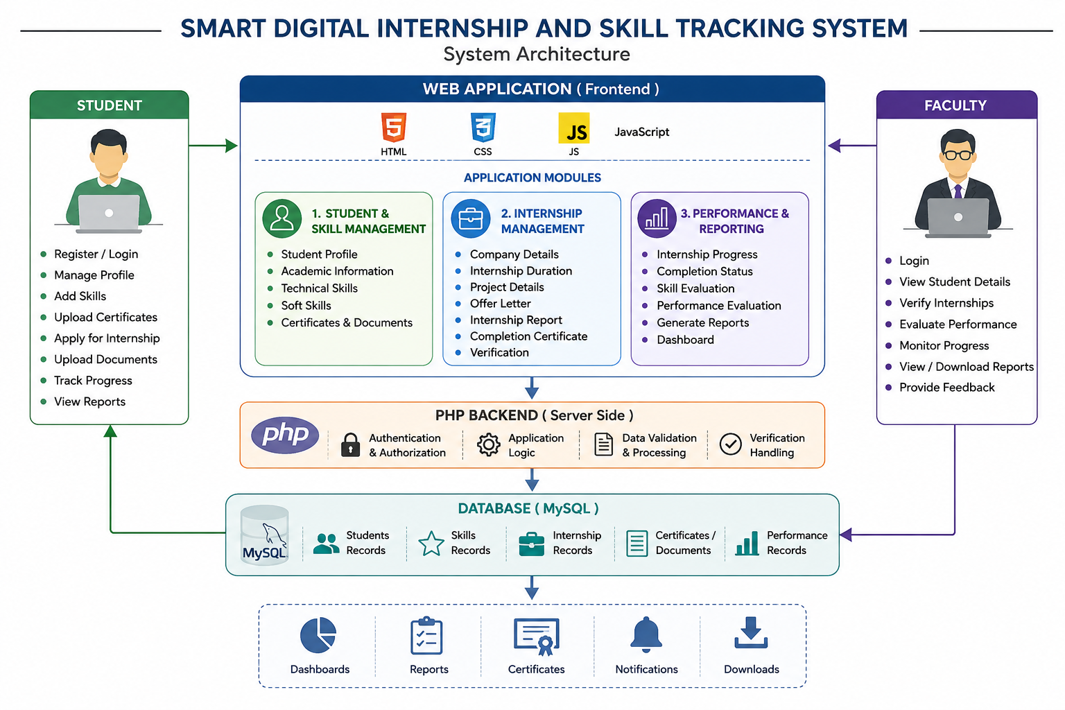
SYSTEM ARCHITECTURE

Slide 7
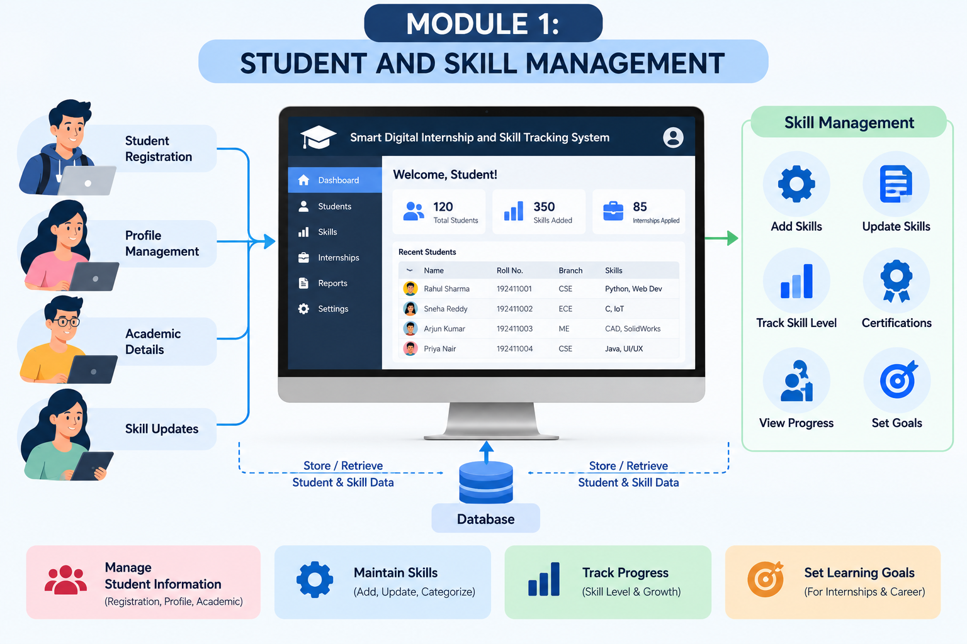
MODULE 1:STUDENT AND SKILL MANAGEMENT
Description:
Manages student profiles, academic information, technical skills, and certifications through a secure web-based platform.
Functions:
Registers students with secure login and authentication.
Maintains personal, academic, and contact information.
Uploads and manages certificates, resumes, and project documents.
Updates student profiles and tracks skill development for internship readiness.

Slide 8
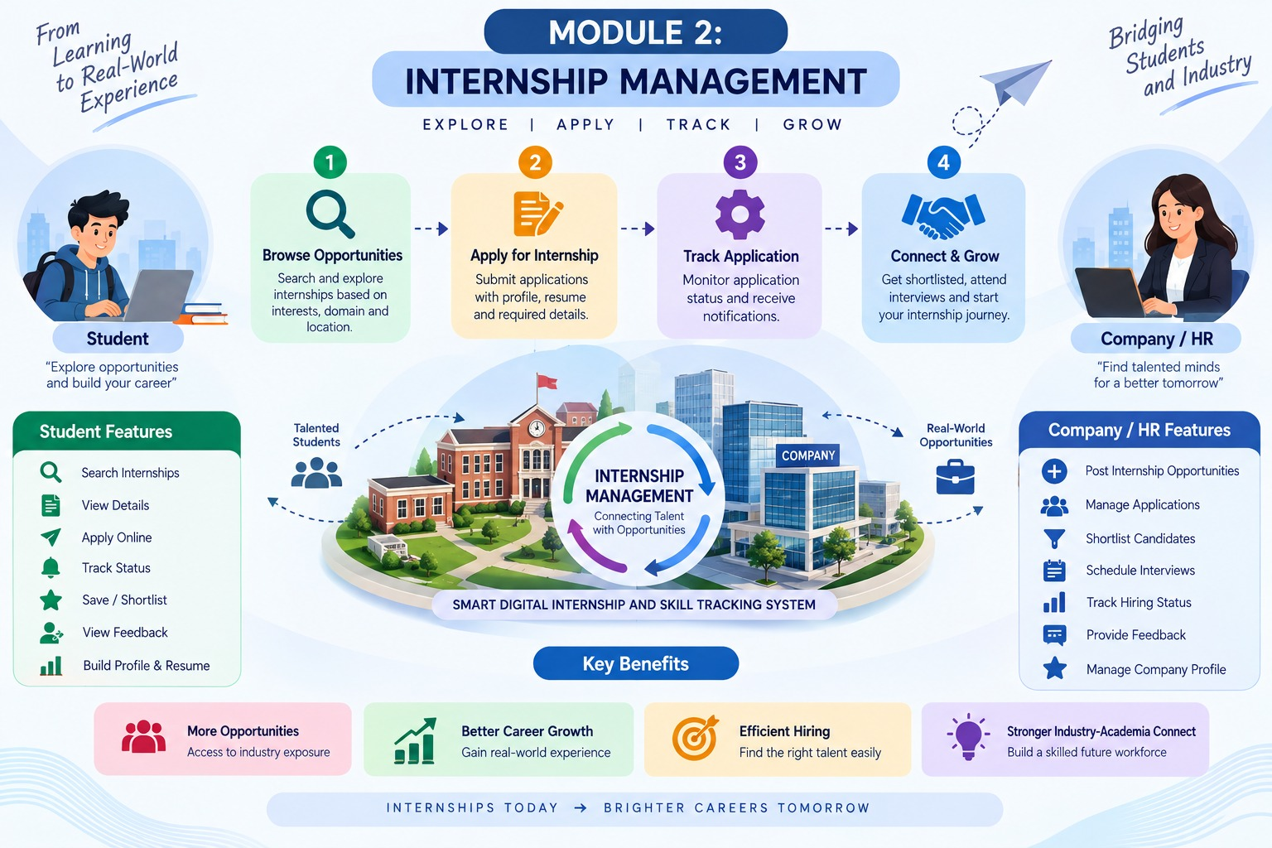
MODULE2 : INTERNSHIP MANAGEMENT
Description:
Manages the complete internship process, from application to completion, while maintaining internship records in a centralized system.
Functions:
Allows students to apply for and register internship details.
Stores company information, internship duration, and project details.
Uploads offer letters, completion certificates, and internship reports.
Enables faculty to verify and approve internship records.
Tracks internship status and completion progress.

Slide 9
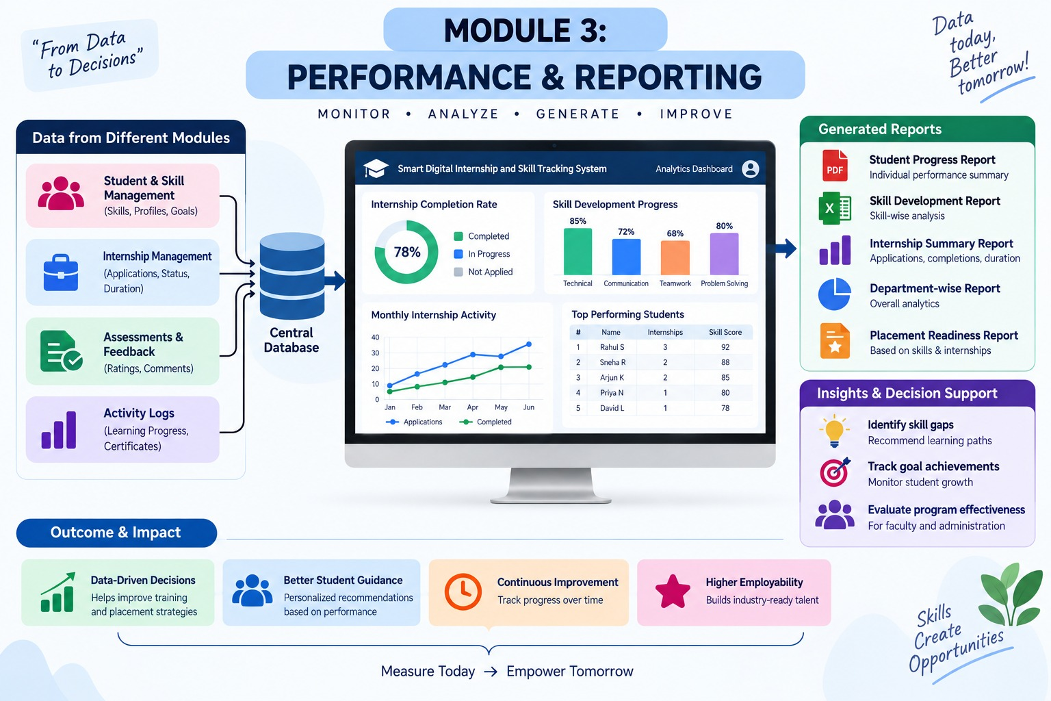
MODULE 3: PERFORMANCE & REPORTING
Description:
Monitors student internship performance, skill development, and generates reports for students and faculty.
Tracks student internship progress and completion status.
Evaluates technical and soft skill development.
Generates internship and skill performance reports.
Provides dashboards for students and faculty to view progress.
Allows downloading of reports and certificates for future reference.

Slide 10
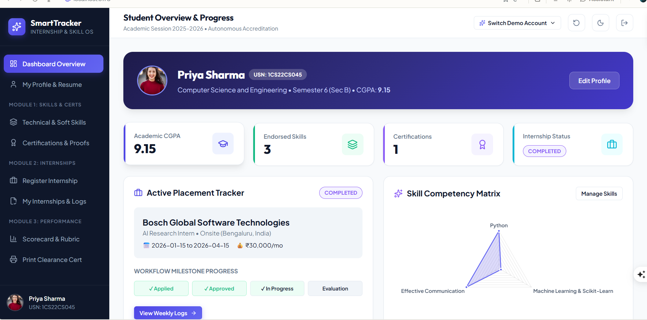
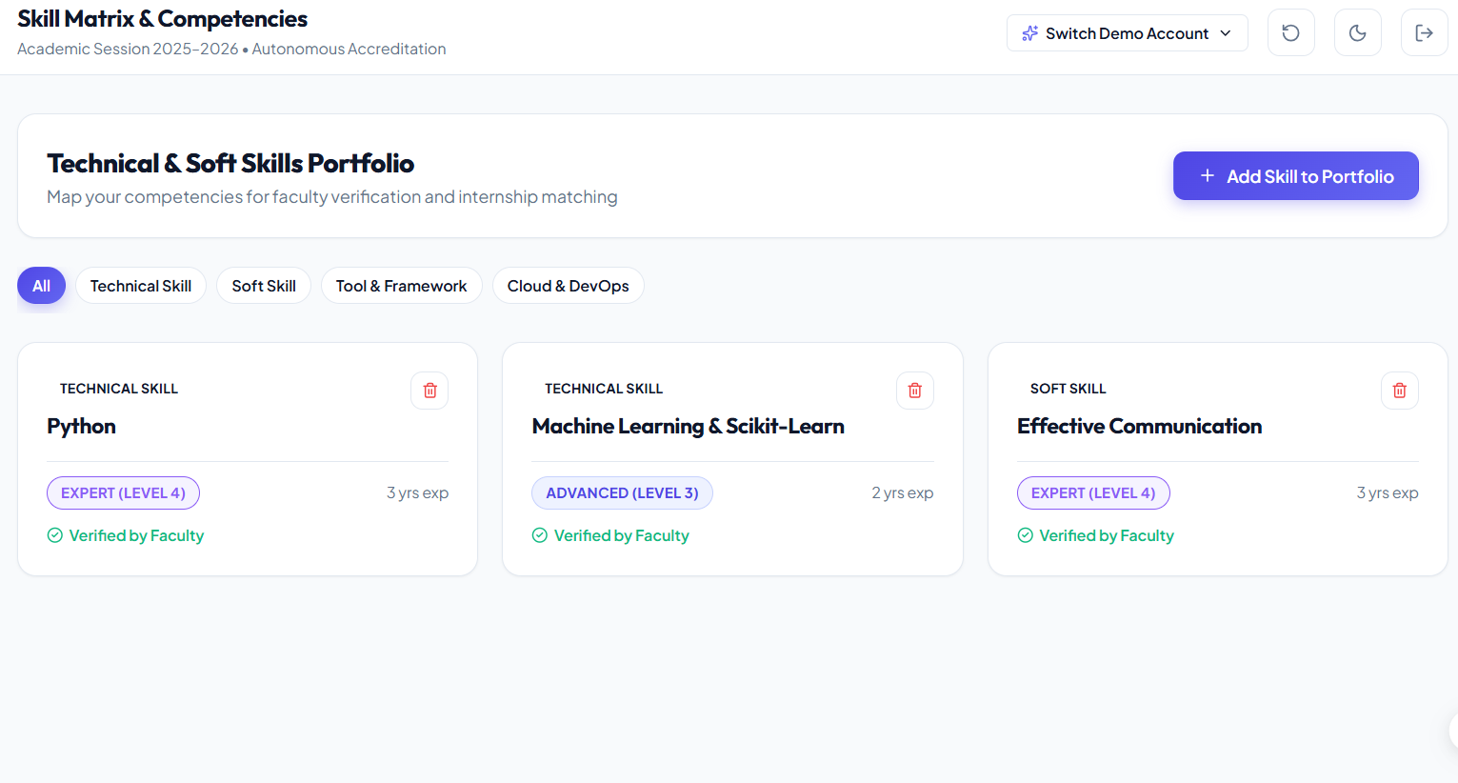
OUTPUT

Slide 11
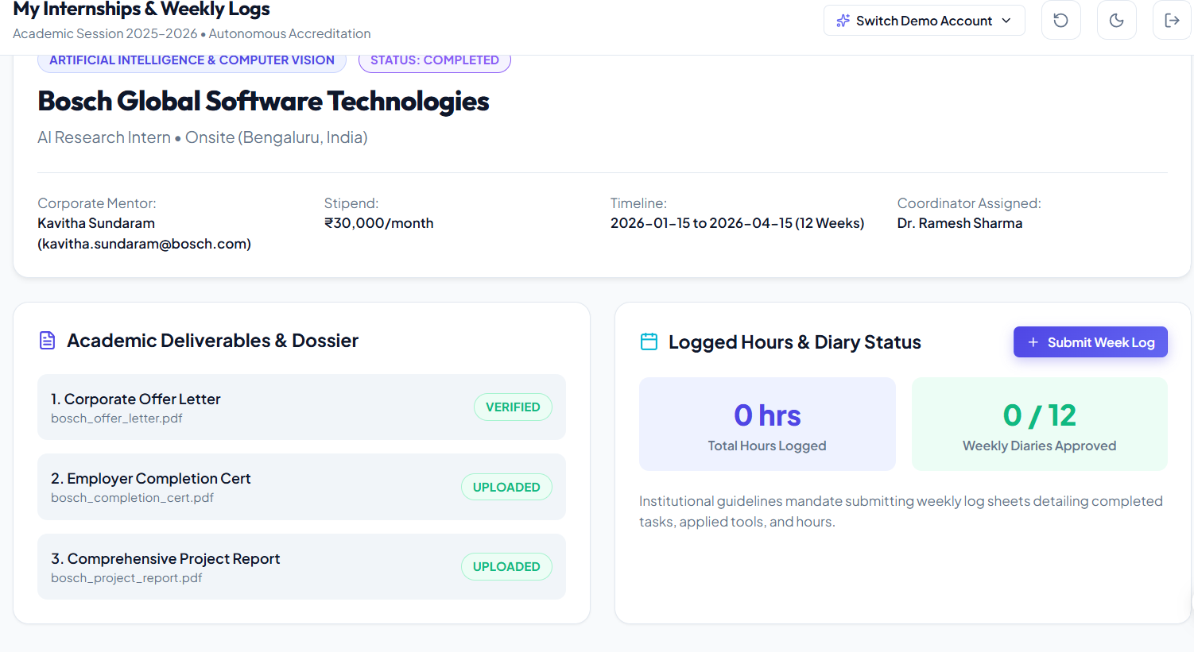

Slide 12
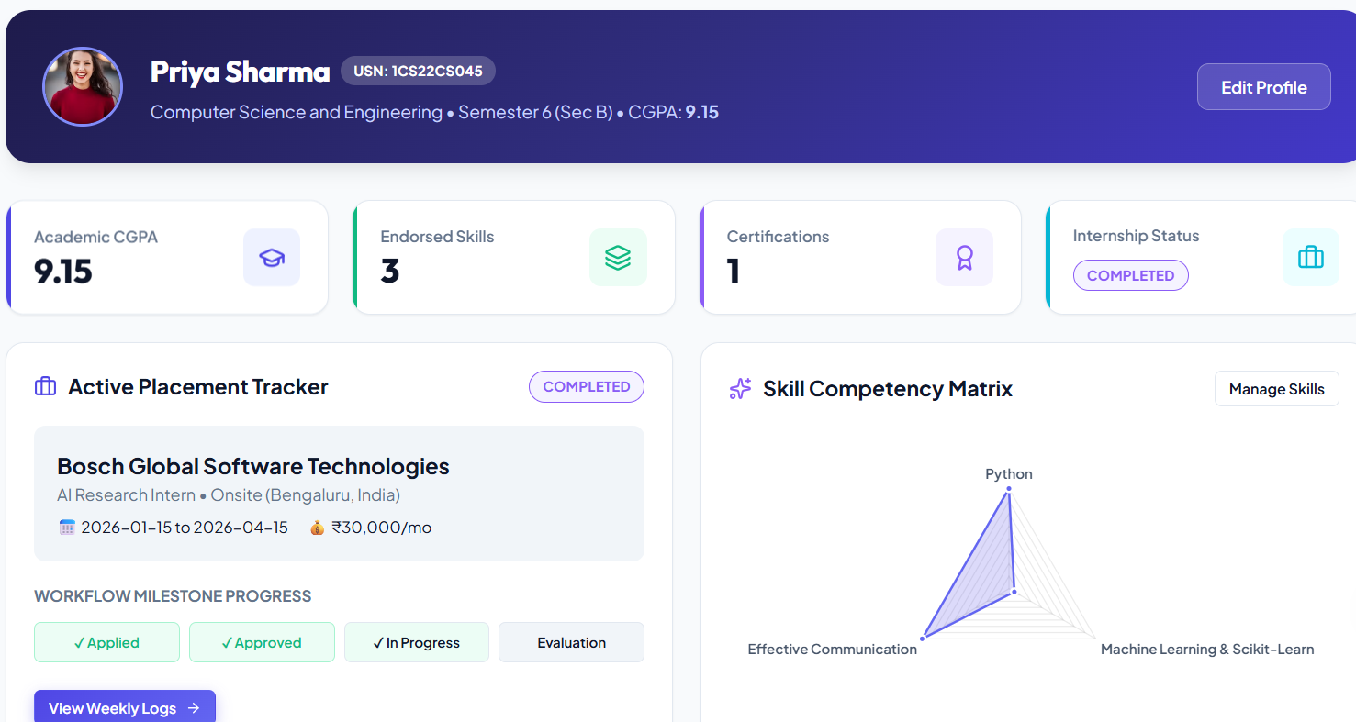

Slide 13
RESULTS & DISCUSSION
The system provides a centralized location for student internship information.
Student profiles, skills and certifications can be maintained in an organized digital format.
Internship details and supporting documents can be accessed without relying on scattered records.
Faculty members receive better visibility into student internship information and progress.
The system provides a structured approach to internship verification and performance evaluation.
Stored information can be used to support reports and internship documentation.
The overall process becomes more systematic, accessible and organized compared with manual record management.

Slide 14
CONCLUSION
The Smart Digital Internship and Skill Tracking System provides a centralized solution for managing student internships and skills.
Key Contributions
Digitizes internship records and student information.
Provides centralized skill and certificate management.
Supports internship registration and document management.
Enables faculty verification and monitoring.
Tracks internship progress and performance.
Simplifies report generation and record management.

Slide 15
FUTURESCOPE
AI-Based Skill Recommendations: Suggest relevant skills based on student profiles.
Mobile Application: Provide access through mobile devices.
Smart Notifications: Send reminders for deadlines and verification.
Advanced Analytics: Provide graphical analysis of skills and performance.
Company Integration: Connect students with internship providers.
Cloud Deployment: Provide scalable access to internship information.

Slide 16
REFRENCES
Duckett, J. (2014). HTML and CSS: Design and build websites. John Wiley & Sons.
Fowler, M. (2004). UML distilled: A brief guide to the standard object modeling language (3rd ed.). Addison-Wesley.
Nixon, R. (2018). Learning PHP, MySQL & JavaScript: With jQuery, CSS & HTML5 (5th ed.). O’Reilly Media.
Pressman, R. S., & Maxim, B. R. (2015). Software engineering: A practitioner’s approach (8th ed.). McGraw-Hill Education.
Silberschatz, A., Galvin, P. B., & Gagne, G. (2018). Operating system concepts (10th ed.). Wiley.
Sommerville, I. (2016). Software engineering (10th ed.). Pearson.
Welling, L., & Thomson, L. (2017). PHP and MySQL web development (5th ed.). Addison-Wesley.
Booch, G., Maksimchuk, R. A., Engle, M. W., Young, B. J., Conallen, J., & Houston, K. A. (2007). Object-oriented analysis and design with applications (3rd ed.). Addison-Wesley.

Slide 17
THANKYOU

